Slide 1

Customer Default Identification Report
Hardik Shahu

Slide 2
Overview of the Tasks
How do you ensure that customers can/will pay their loans?
Can we approve customers with high certainty?

Slide 3
Gathering and Preparing the Data
For this project, we weren’t given the data, instead, we had to query the data and extract it to a local file. However, we couldn’t just work with that as initially, the data had to cleaned and prepped up so the analysis tools would be able to work with it properly.
For example, one thing we did was to convert all the them into numeric values. This is crucial as the algorithms requires the data to be numeric as otherwise it would simply not work.

Slide 4
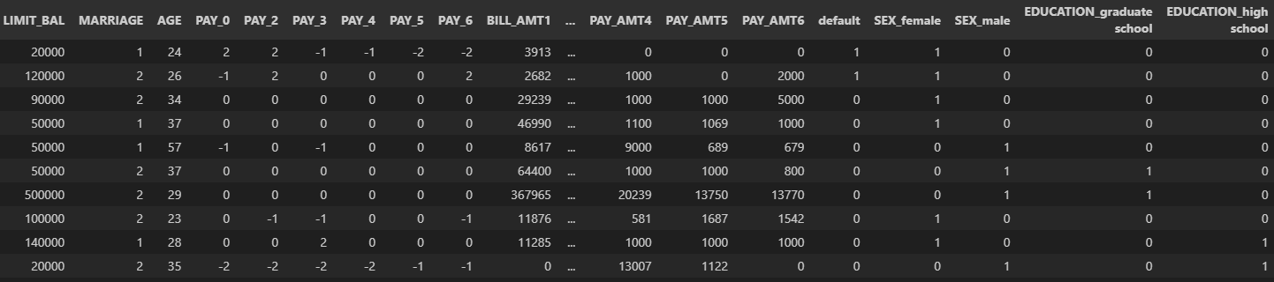
Looking at the data
Down below is a snippet of the data that we used today. Not every column is shown but the two important ones are. Such as “LIMIT_BAL” and “default”; these are important because these represent how much balance each person will receive and whether that person will default or not. As such, these were our dependent variables for today's tests.

Slide 5
Different types of Tests
For this project, there were two main machine learning tests that we used, they were Regression and Classification. Both tests are valid and useful for different types of data.
Regression is predominantly used when the dependent variable consists of the raw values that can be an integer or decimal. For example, if we have ages, then entries can include 9, 15 or 28.
Classification is used when we have the dependent variable is already converted into a group or the raw data is such that it is already discretized . For example, if we use age, we will assign a number depending on where a given age lands in a range. (ages 1-9 = 0, 10-19 = 1 , 20-29 = 2 etc.) Another example can be if the variable is result of a coin toss, by nature this is binary and thus we would only use values of 1 or 0.

Slide 6
Test 1: Regression on Limit Balance
For this test, we ran a few regression algorithms for when the “LIMIT_BAL” (Limit Balance) was the dependent variable to see which one would be the best.
The three choices were Random Forest Regressor, Linear Regression and Support Vector Regression.
To see which model is the best fit, we found the cross-validation score (CVS) of each. CVS is ranged between -1 to 1. The closer it is to the endpoints, the better that algorithm is for a given data.
The CVS that we calculated were 0.768, 0.382 and -0.040 (respectively).
Which means that for our data, Random Forest Regressor would be the best algorithm.

Slide 7
Test 1: Regression on Limit Balance Cont.
Using Random Forest Regressor, we built a model and did a couple of tests with it. To be more precise, we found the r-squared value and plotted a scatter plot.
When we say model, what we mean is we take a large portion of out data entries and train them using algorithm (Random Forest). After this, the model should be able to predict the dependent variable (Limit Balance). To test if it does, we use the remaining entries to see if the model works well, or how well it works.

Slide 8
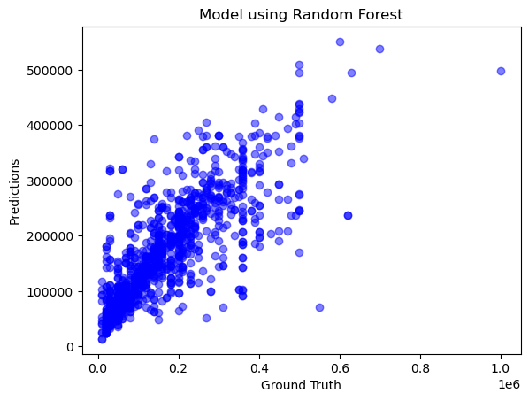
Test 1: Regression on Limit Balance Cont. 2
On the right, is the scatter plot of the model results. As you can see, there the data seems to correlate nicely as, while its not a perfect line, all the data does seem to match in a pattern.
we also calculated the r-squared value, which was 0.621(r-squared value is similar CVS where it ranges from -1 to 1 and the closer it is to the endpoints, the better it is). Therefore, having a r-squared value of 0.621 tells us that Random Forest Regressor can be a decent predictor.

Slide 9
Test 2: Classification on Limit Balance
While the previous test had decent results, we might be able to do better and one way would be to run another test on Limit Balance, this time being Classification.
In other to do this, we converted the Limit Balance column so that instead of it being a range from 10,000 to 1,000,000, it would be discretized into buckets of 1-100.
This time, we used Random Forest Classifier and Decision Tree Classifier for my algorithms and the respective CVS results were 0.754 and 0.729.
While these results are good, but unfortunately, this tells us that using either of these two classification algorithms wouldn’t be much better than the Random Forest Regressor from Test 1.
Therefore, for Limit Balance using Random Forest Regressor would be best with Random Forest Classifier and Decision Tree Classifier as good alternatives.

Slide 10
Test 3: Classification on Default
For our second variable, I ran classification for the variable default.
Since by nature this is binary value, I didn’t need to modify the values.
I tested with the same two algorithms, Random Forest Classifier and Decision Tree Classifier and the respective CVS results were 0.940 and 0.913.
This tells us that we can use either algorithm to build a model and predict whether or a given person will default or not.
Therefore, for default, the best one to use would be Random Forest Classifier with Decision Tree Classifier being a good alternative.

Slide 11
Conclusion
How do you ensure that customers can/will pay their loans?
We can ensure that customers will pay their loans by building a model that uses Random Forest Classifier.
Can we approve customers with high certainty?
We will be able to determine how much money we can lend a customer by building model using Random Forest Regressor

Slide 12
Interesting Insight
One interesting thing we noticed while working on this project was that the Random Forest algorithms are pretty good, both the regressor and classifier. We’re not 100% certain that it would be the best for all data types, but so far, it has worked well. So, for future works we’ll definitely use these algorithms to find out what model is the best fit!

